Slide 1
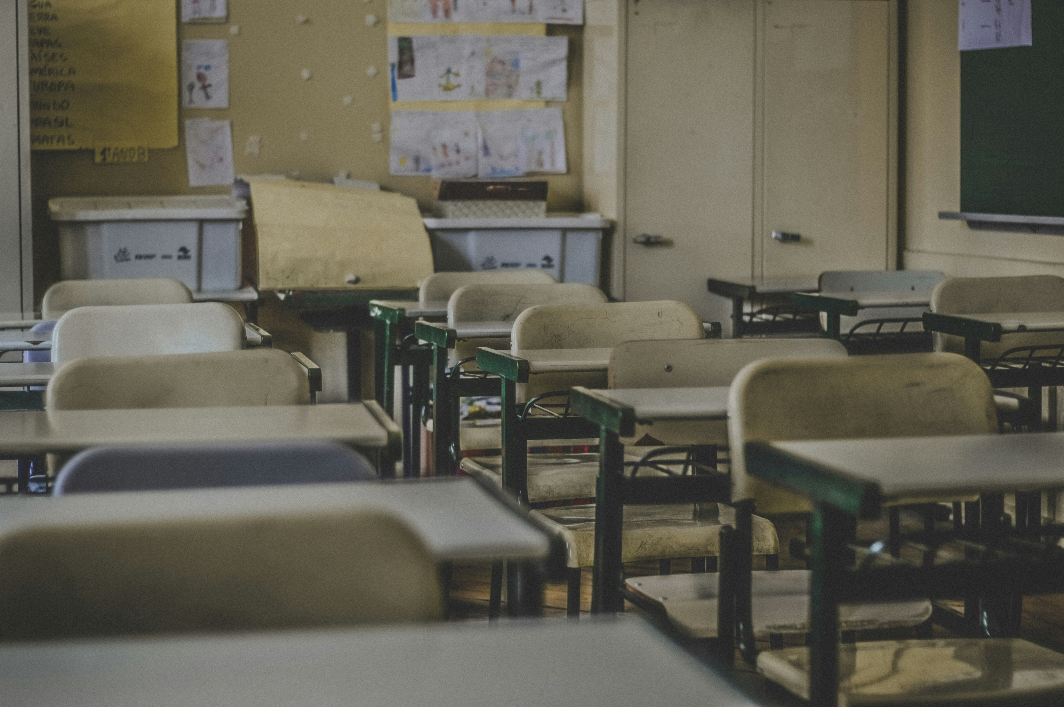
校園故事
Notes:
https://unsplash.com/photos/photography-of-school-room-hes6nUC1MVc

Slide 2
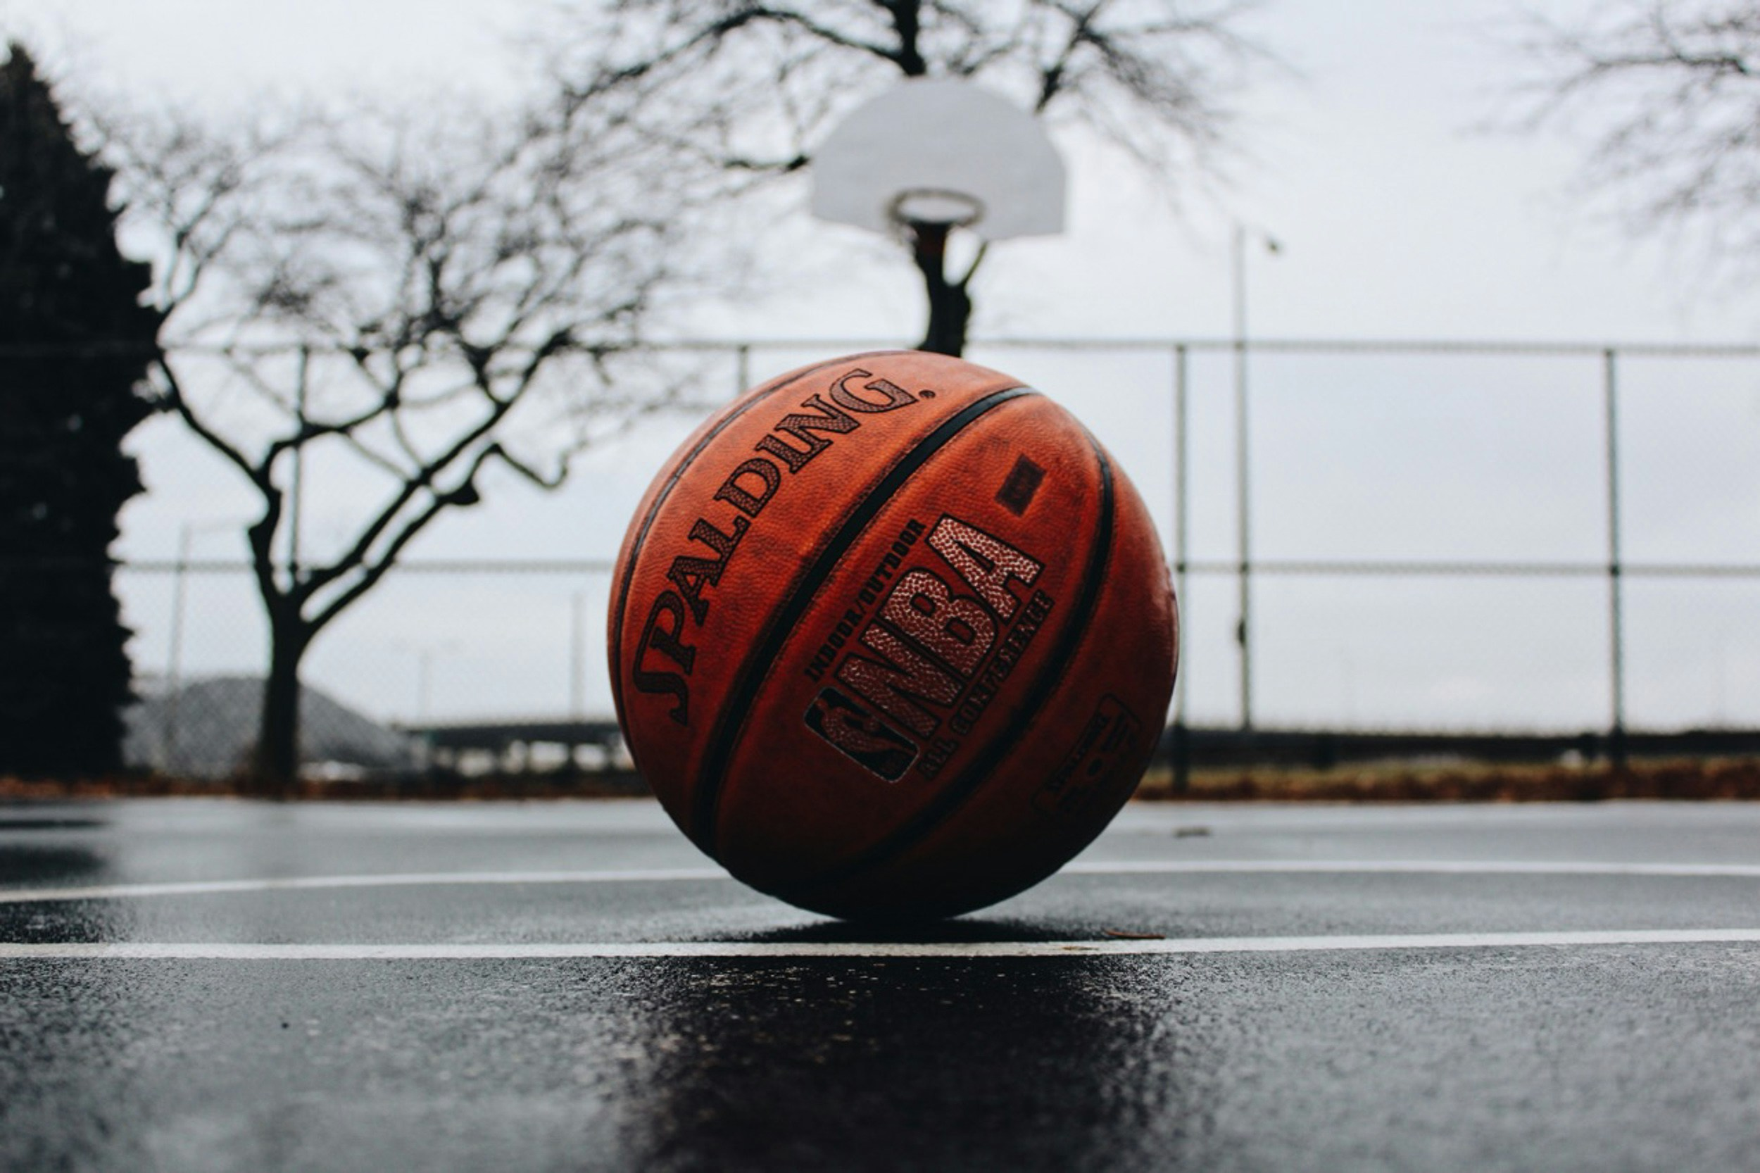
1.目標
Notes:
https://unsplash.com/photos/spalding-basketball-in-court-Gl0jBJJTDWs

Slide 3
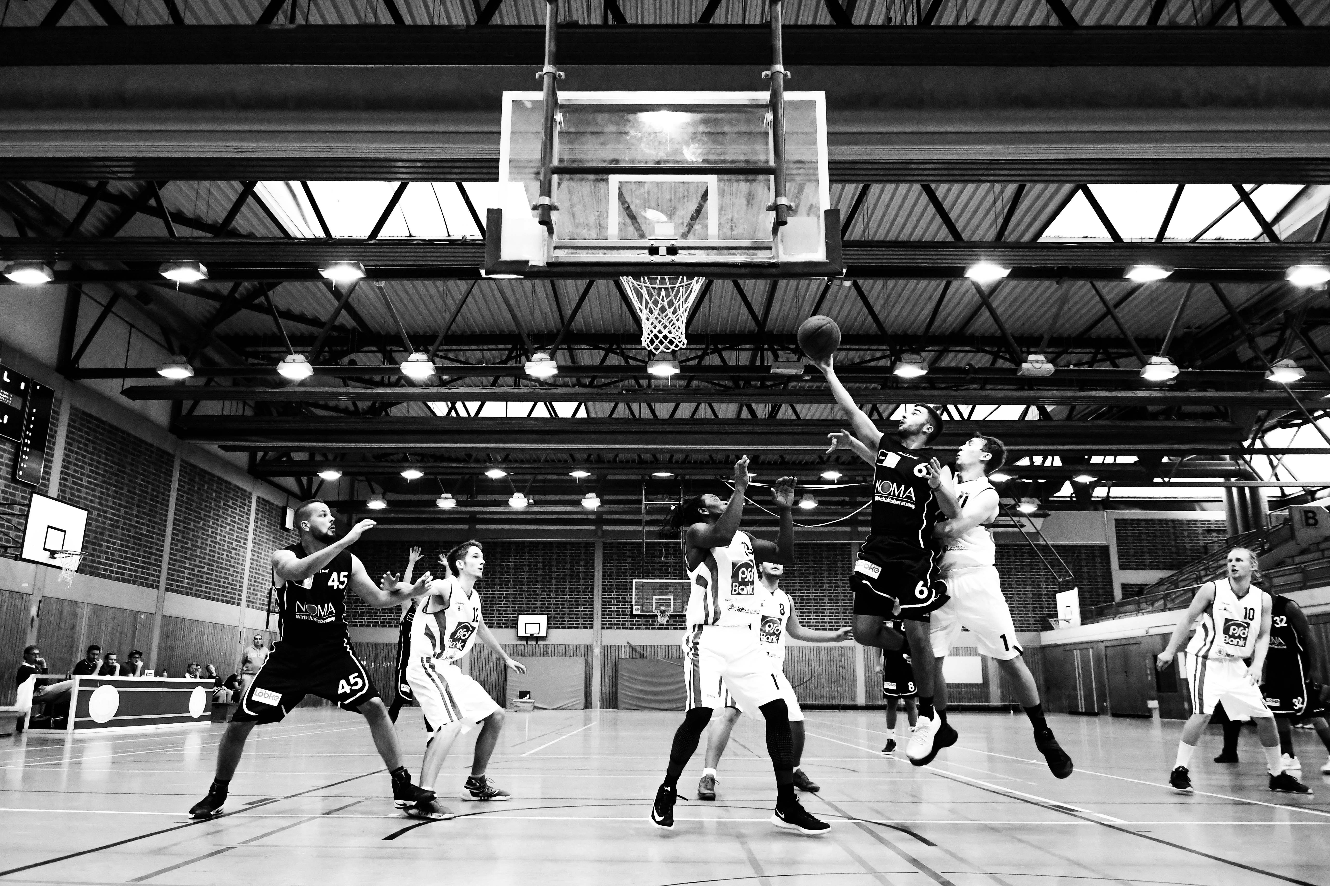
2.阻礙
Notes:
https://unsplash.com/photos/grayscale-basketball-players-UFIZodJgScQ

Slide 4
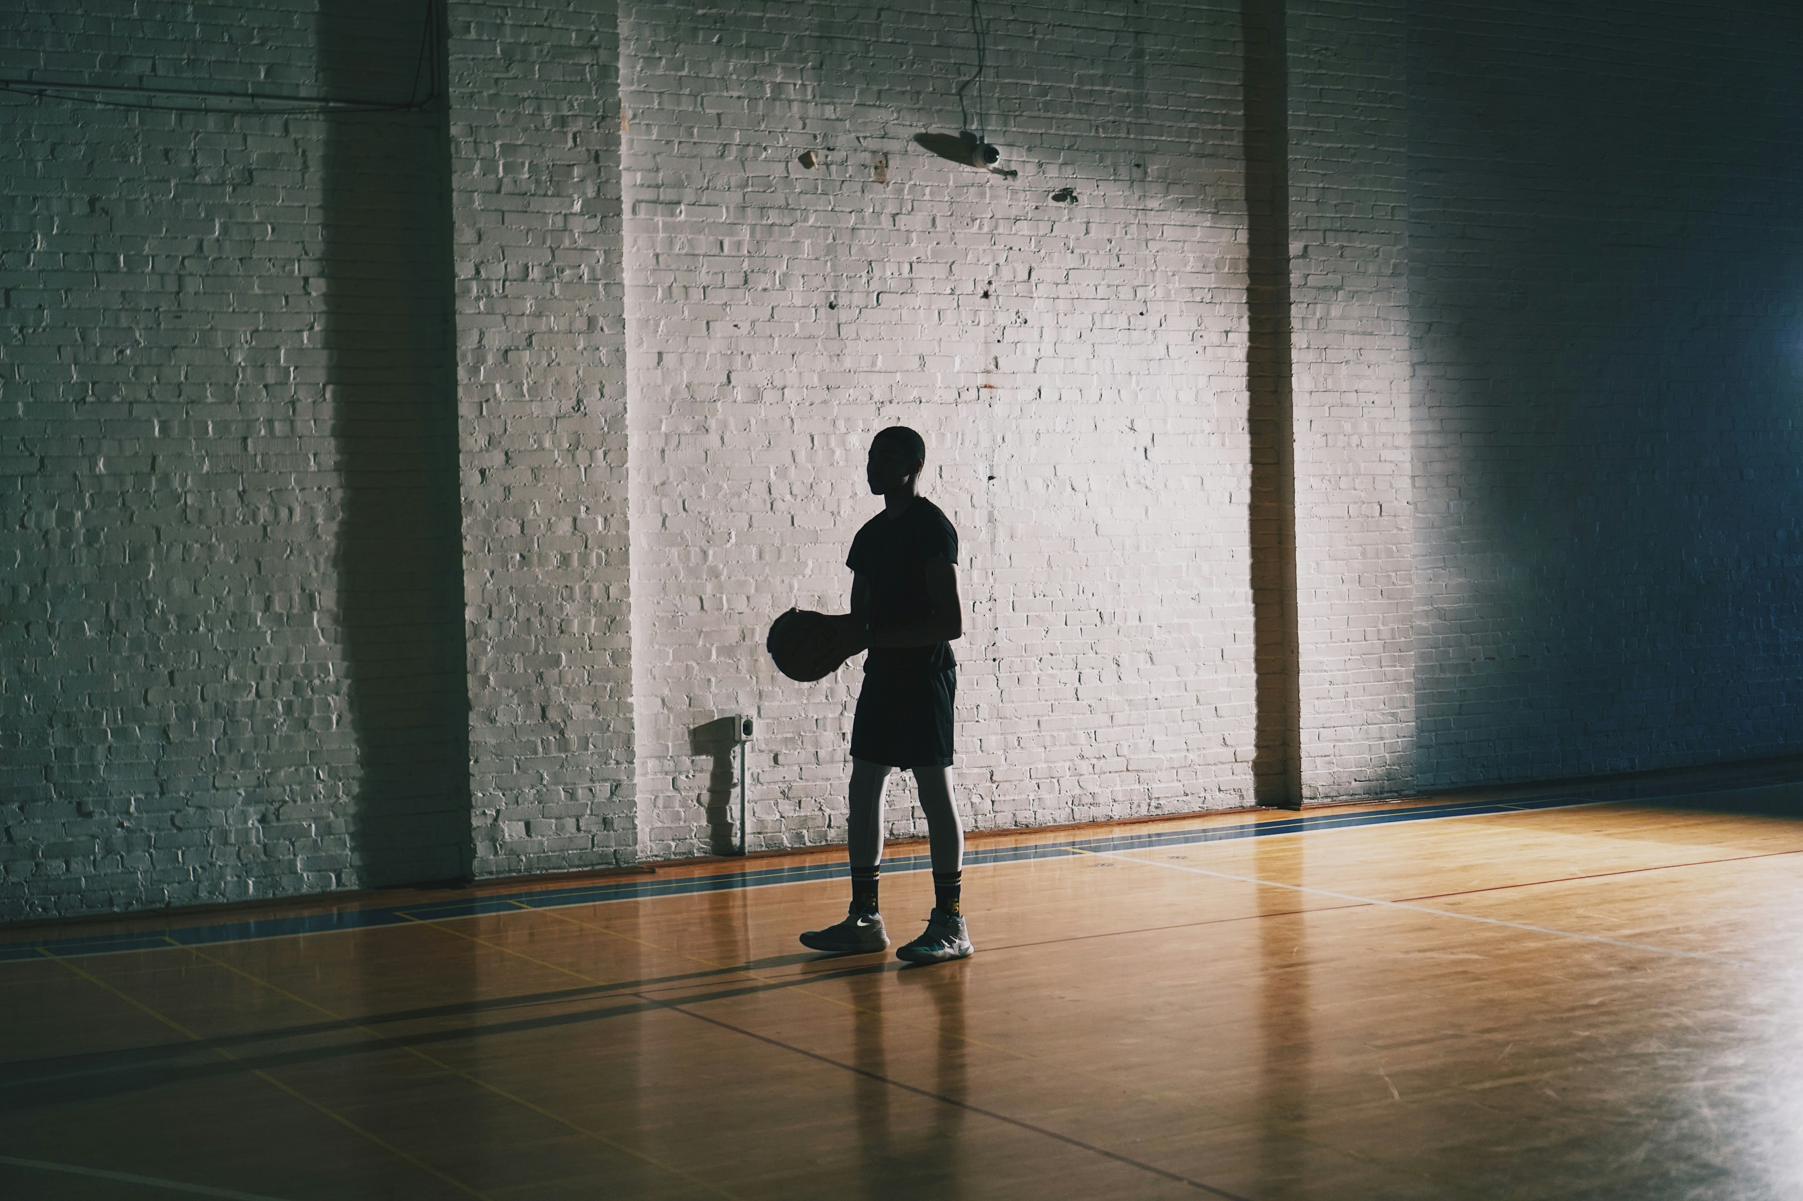
3.努力
Notes:
https://unsplash.com/photos/man-holding-basketball-fz92ybo3N0M

Slide 5
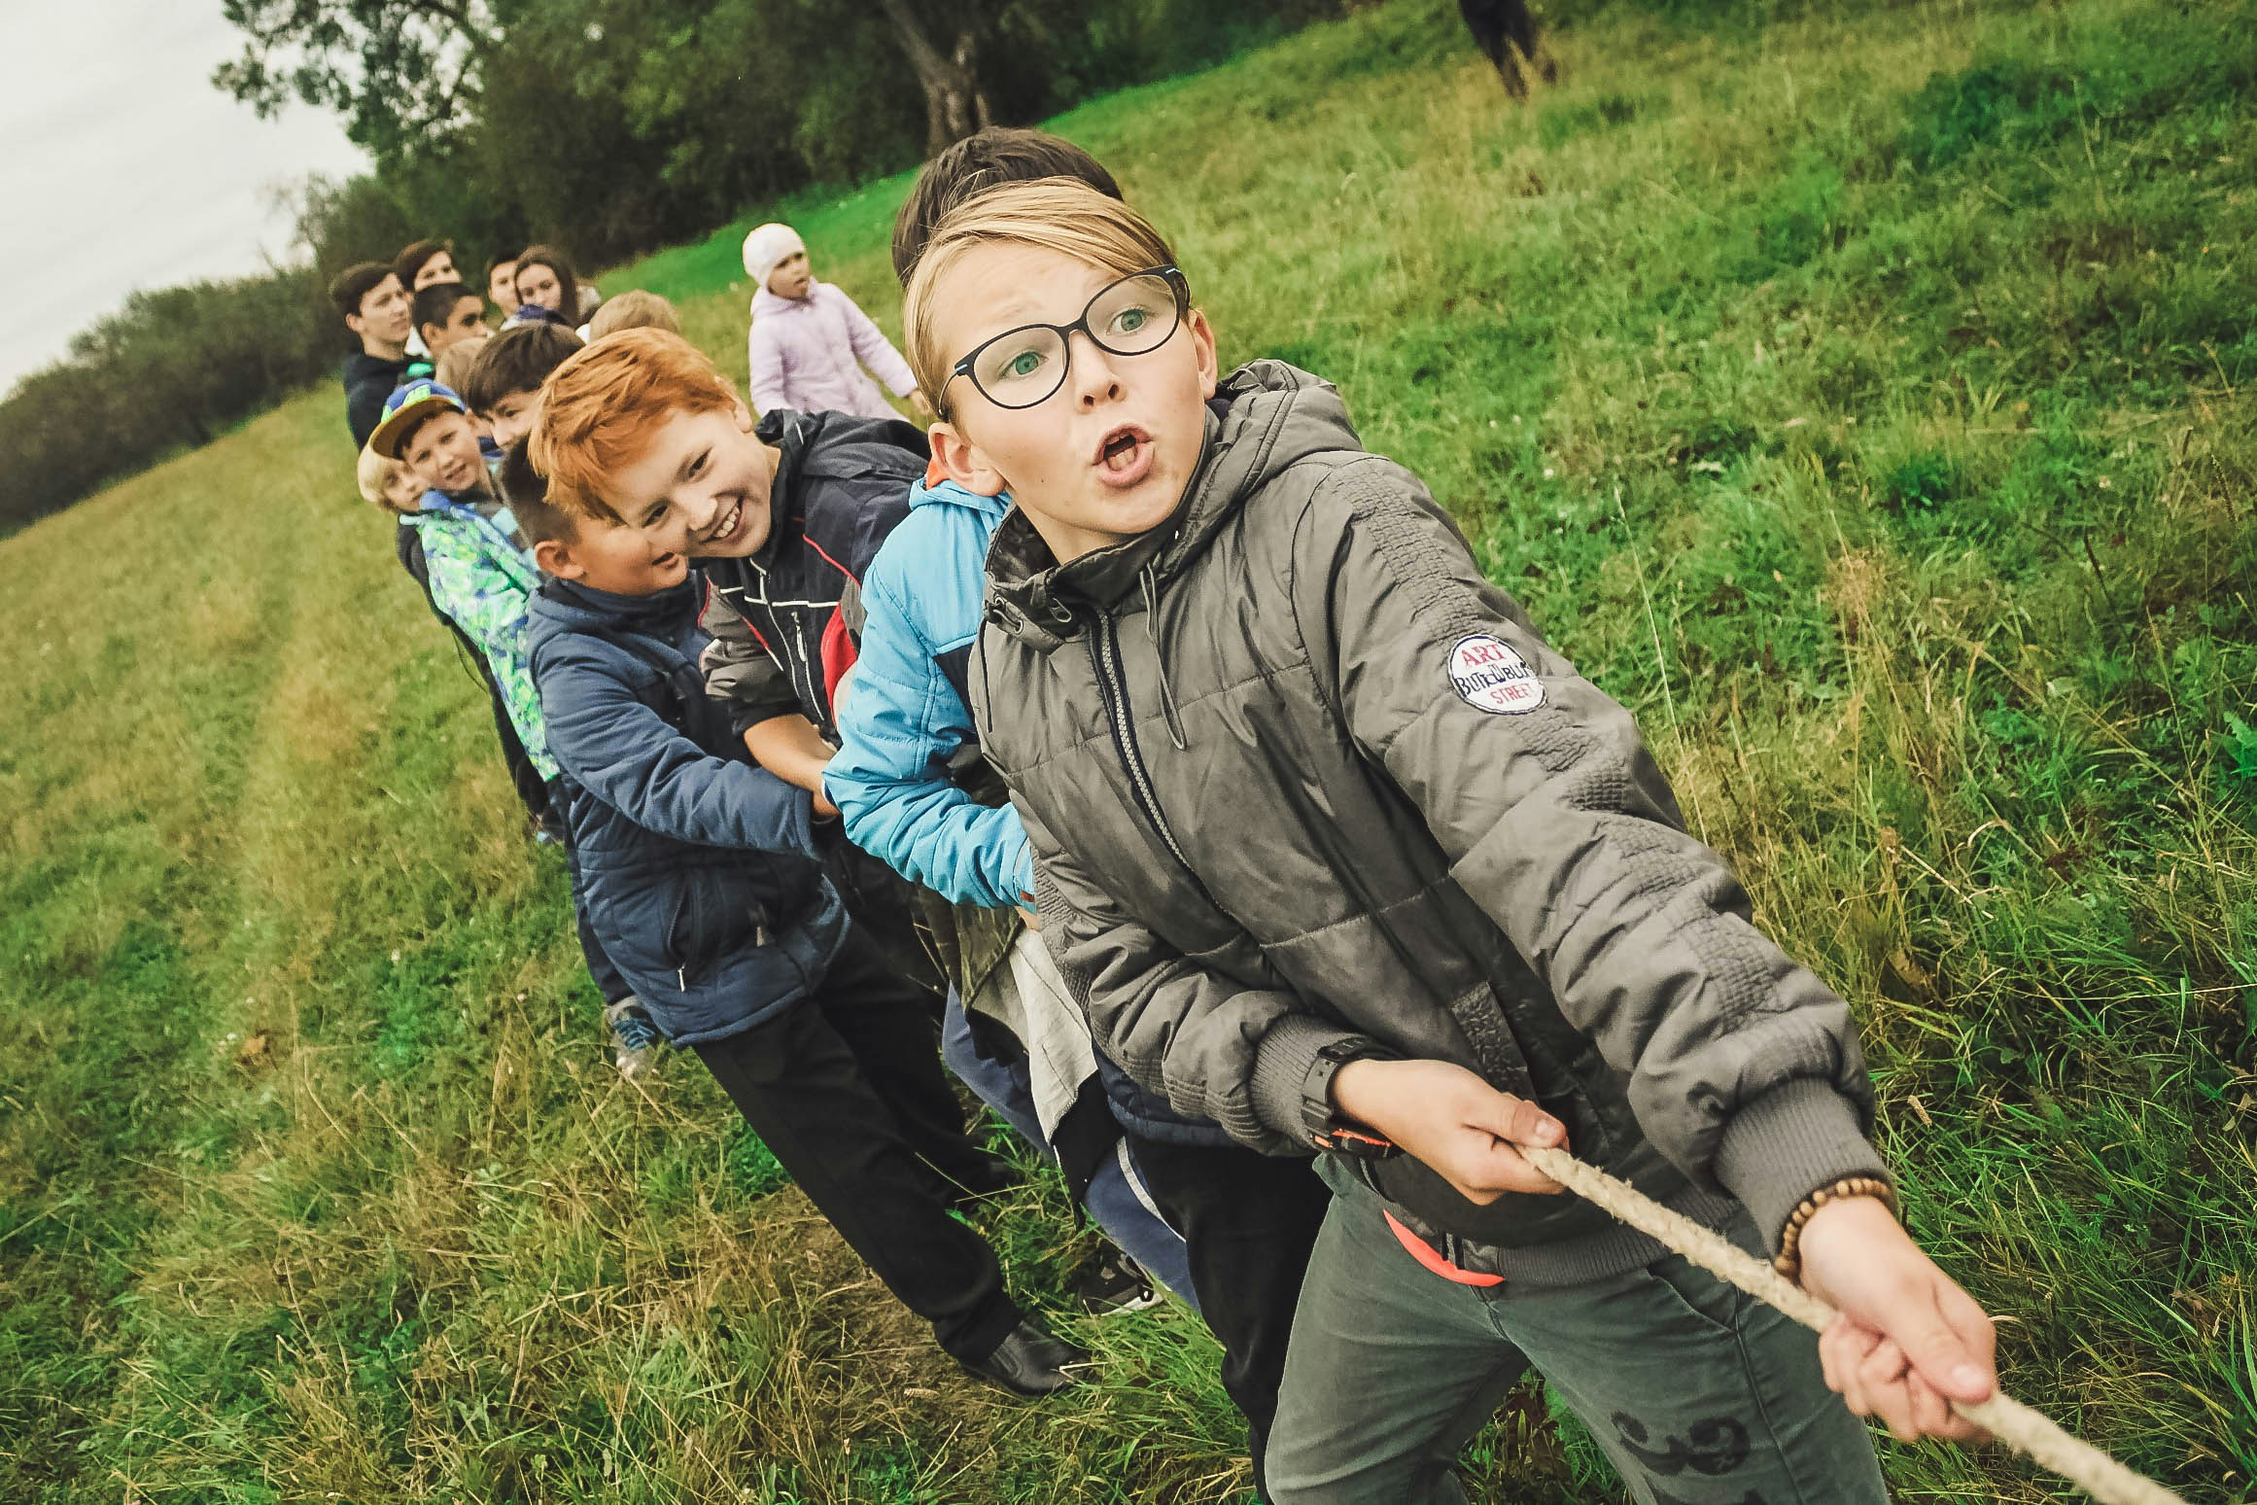
4.結果
Notes:
https://unsplash.com/photos/group-of-children-pulling-brown-rope-w55SpMmoPgE

Slide 6
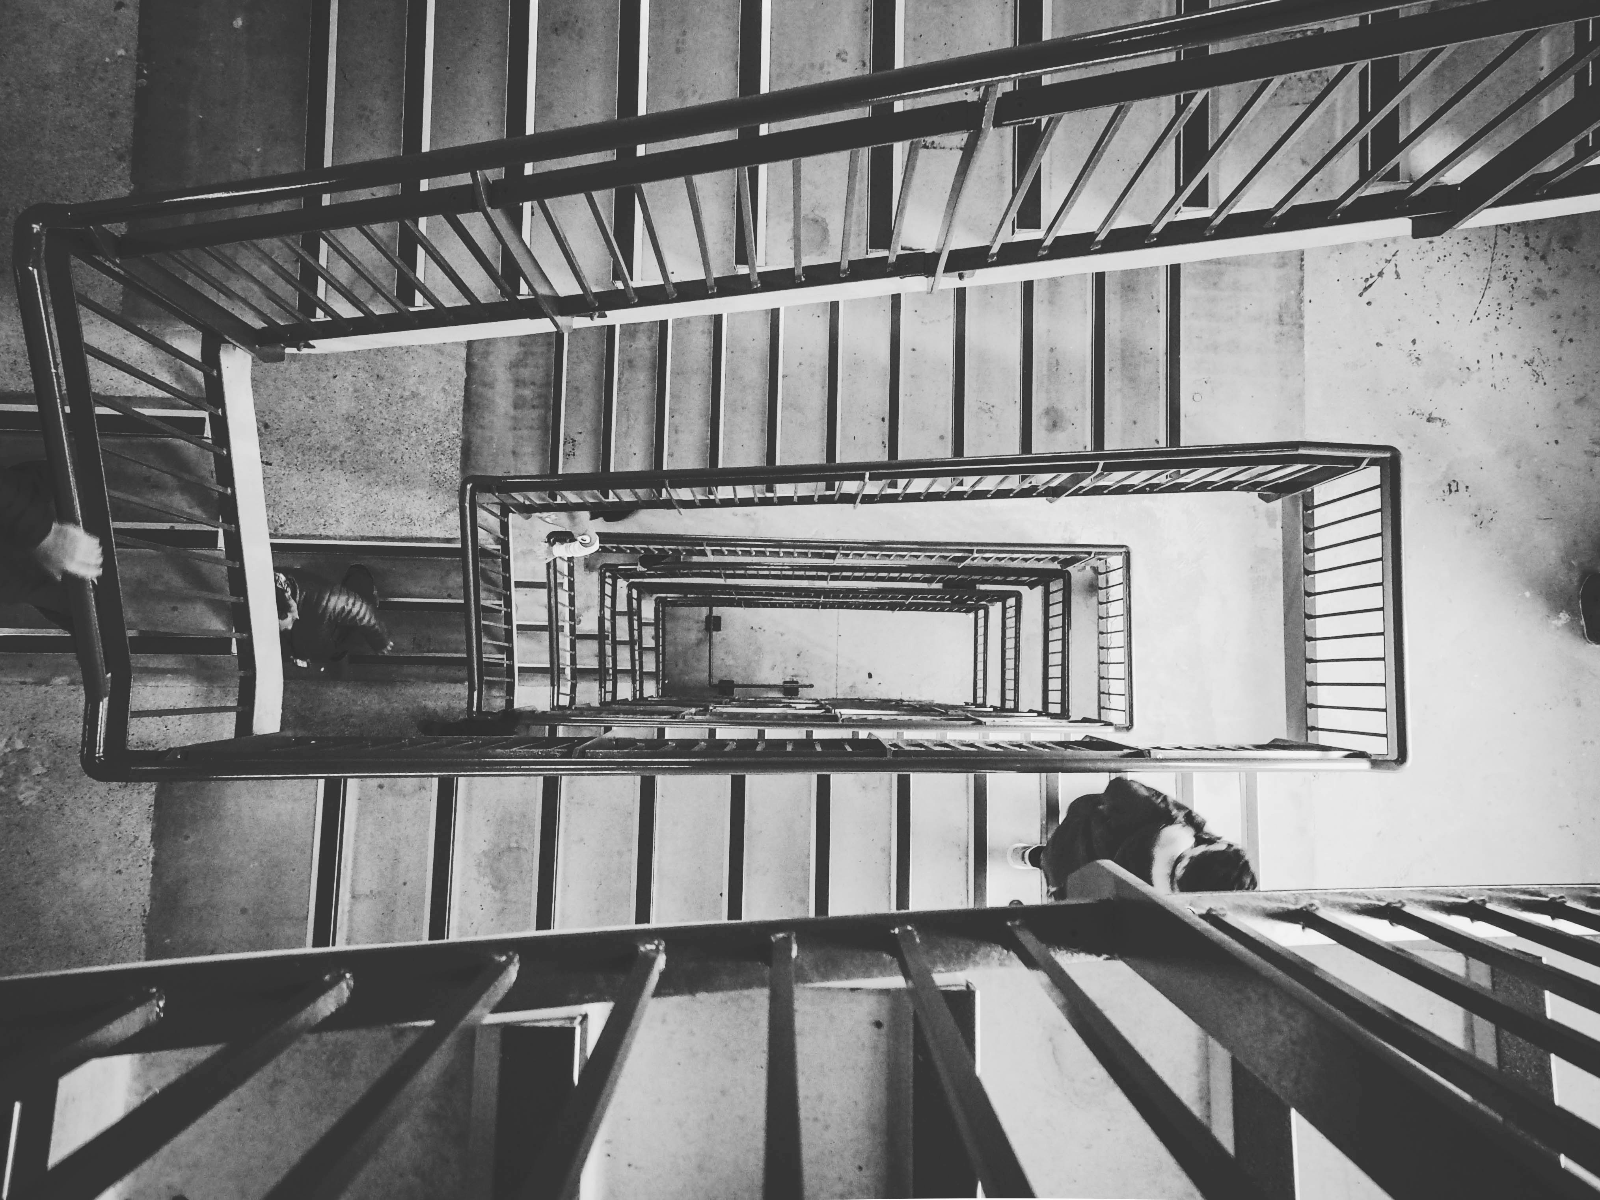
5.意外

Slide 7
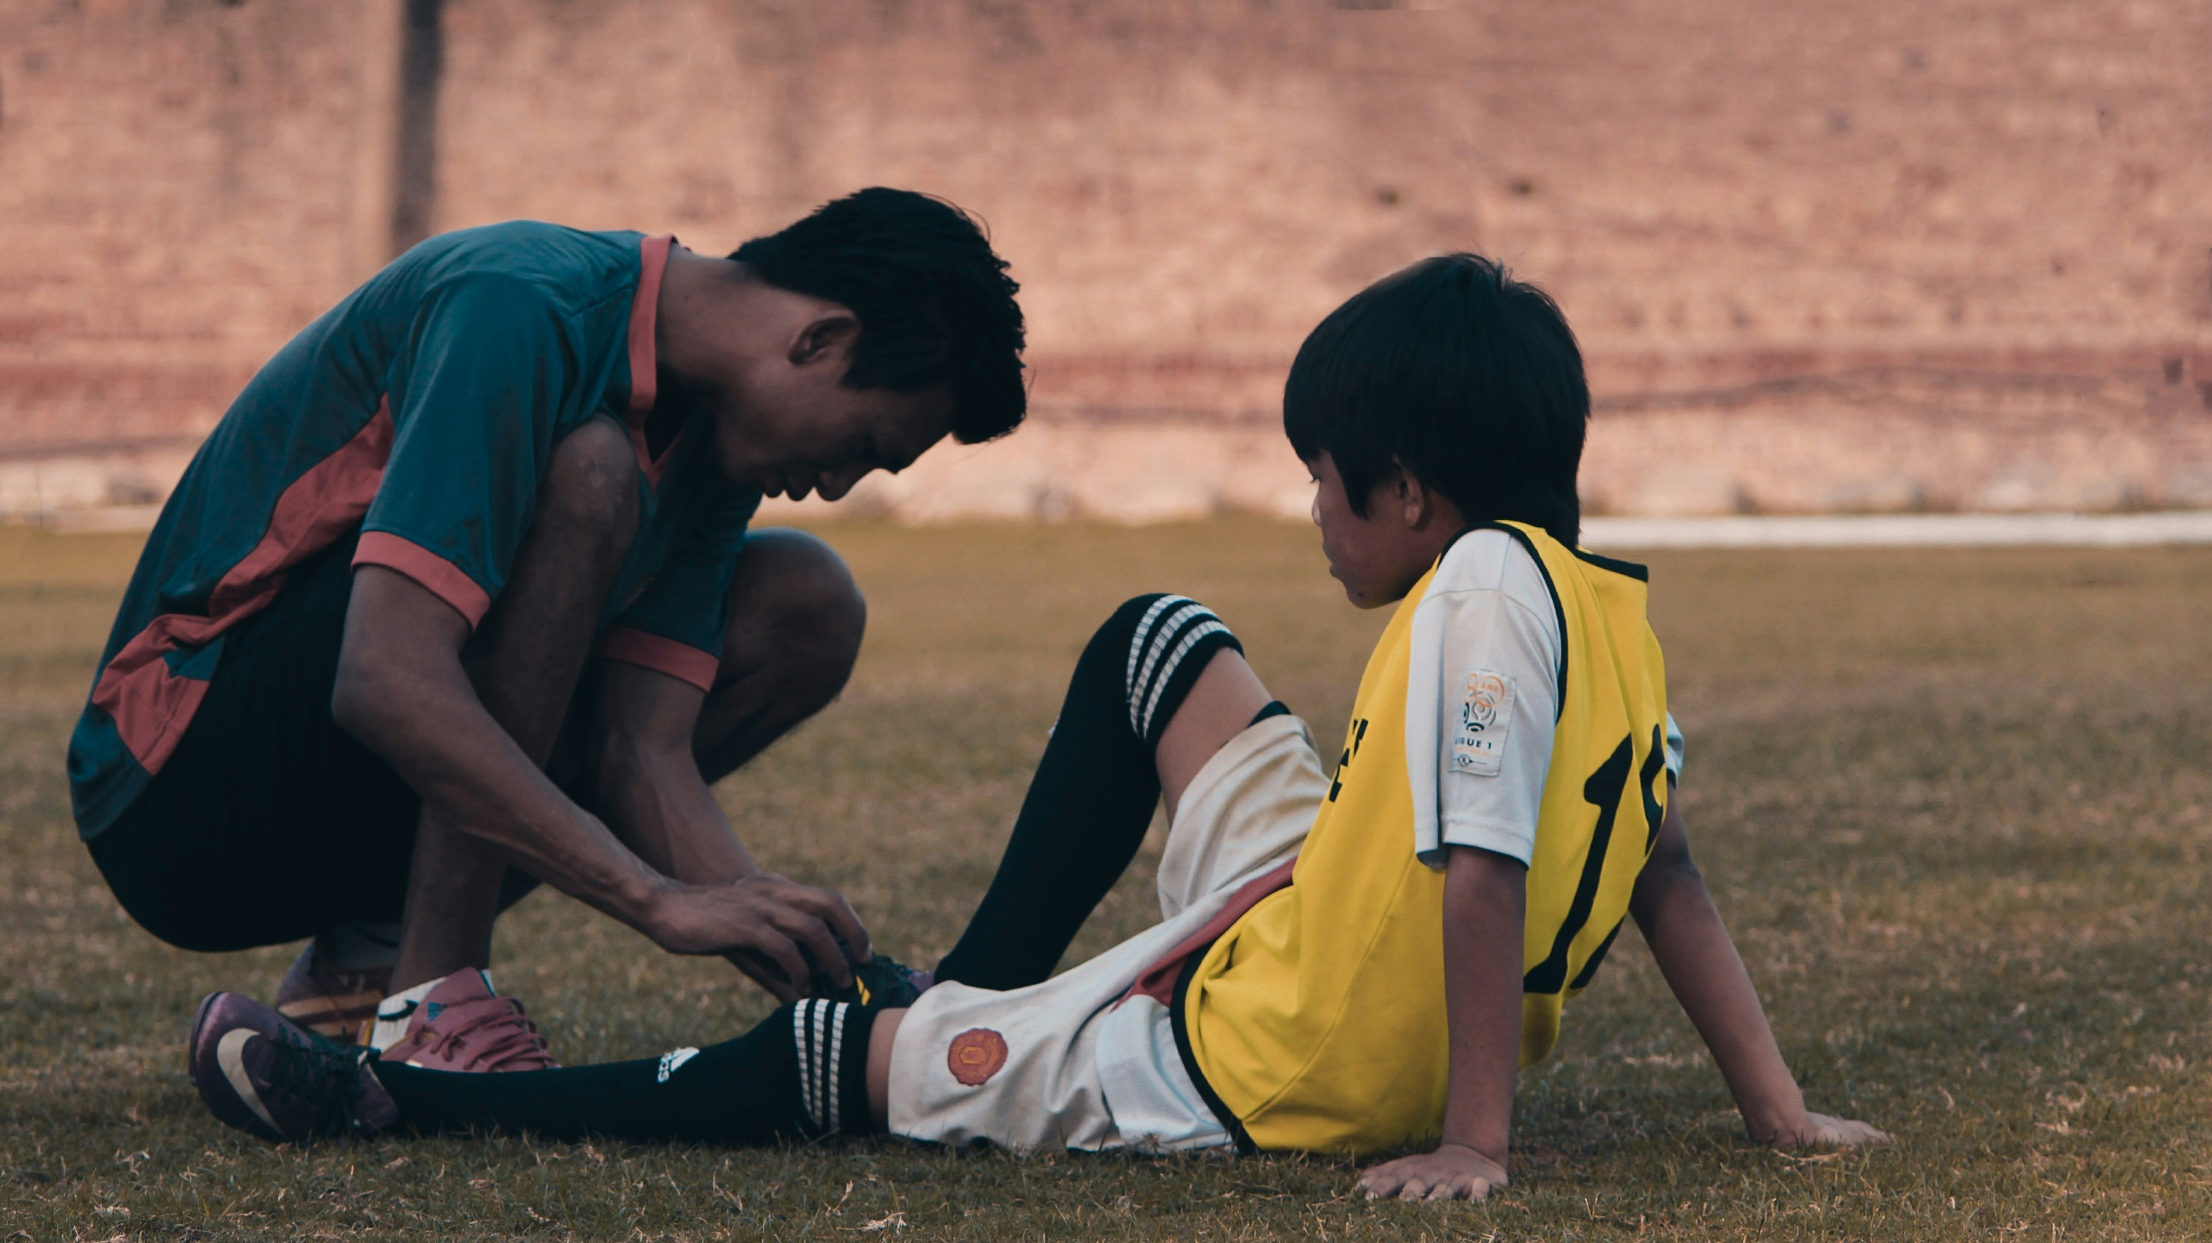
6.轉彎
Notes:
https://unsplash.com/photos/2-men-in-red-and-white-jersey-shirt-sitting-on-ground-during-daytime-KtPJkTlke8Y

Slide 8
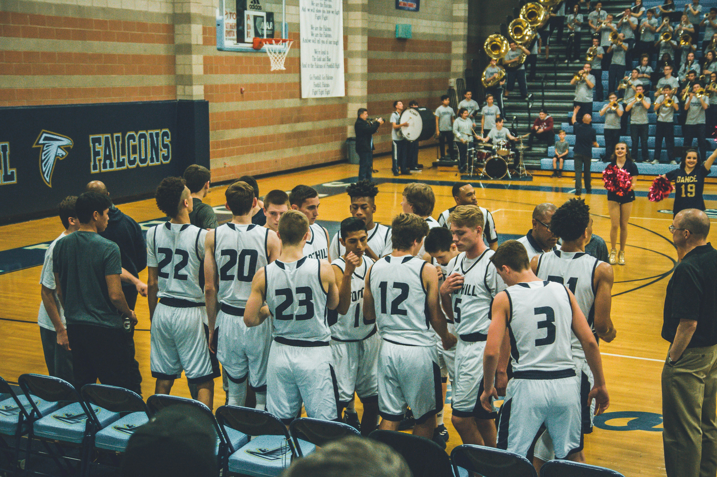
7.結局
Notes:
https://unsplash.com/photos/basketball-team-standing-on-courtside-O4zhy0zLAQc

